Slide 1
Running Python

Slide 2
The Python Interpreter
Typical Python implementations offer both an interpreter and compiler
Interactive interface to Python with a read-eval-print loop
[finin@linux2 ~]$ python
Python 2.4.3 (#1, Jan 14 2008, 18:32:40)
[GCC 4.1.2 20070626 (Red Hat 4.1.2-14)] on linux2
Type "help", "copyright", "credits" or "license" for more information.
>>> def square(x):
... return x * x
...
>>> map(square, [1, 2, 3, 4])
[1, 4, 9, 16]
>>>

Slide 3
Installing
Python is pre-installed on most Unix systems, including Linux and MAC OS X
The pre-installed version may not be the most recent one (2.6.2 and 3.1.1 as of Sept 09)
Download from http://python.org/download/
Python comes with a large library of standard modules
There are several options for an IDE
IDLE – works well with Windows
Emacs with python-mode or your favorite text editor
Eclipse with Pydev (http://pydev.sourceforge.net/)

Slide 4
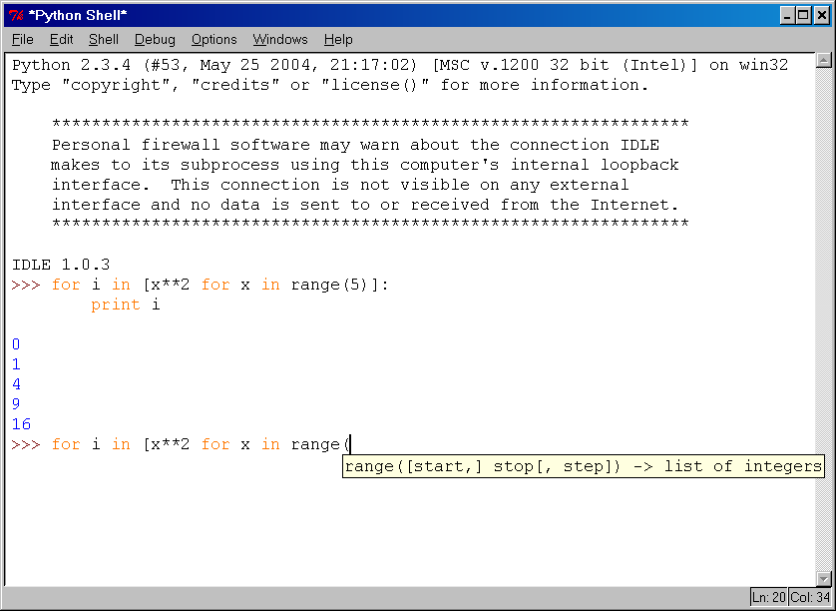
IDLE Development Environment
IDLE is an Integrated DeveLopment Environ-ment for Python, typically used on Windows
Multi-window text editor with syntax highlighting, auto-completion, smart indent and other.
Python shell with syntax highlighting.
Integrated debugger with stepping, persis- tent breakpoints, and call stack visi- bility

Slide 5
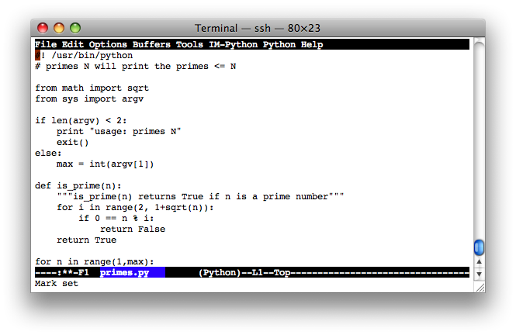
Editing Python in Emacs
Emacs python-mode has good support for editing Python, enabled enabled by default for .py files
Features: completion, symbol help, eldoc, and inferior interpreter shell, etc.

Slide 6
Running Interactively on UNIX
On Unix…
% python
>>> 3+3
6
Python prompts with ‘>>>’.
To exit Python (not Idle):
In Unix, type CONTROL-D
In Windows, type CONTROL-Z + <Enter>
Evaluate exit()

Slide 7
Running Programs on UNIX
Call python program via the python interpreter
% python fact.py
Make a python file directly executable by
Adding the appropriate path to your python interpreter as the first line of your file
#!/usr/bin/python
Making the file executable
% chmod a+x fact.py
Invoking file from Unix command line
% fact.py

Slide 8
Example ‘script’: fact.py
#! /usr/bin/python
def fact(x): """Returns the factorial of its argument, assumed to be a posint"""
if x == 0:
return 1
return x * fact(x - 1)
print
print ’N fact(N)’
print "---------"
for n in range(10):
print n, fact(n)

Slide 9
Python Scripts
When you call a python program from the command line the interpreter evaluates each expression in the file
Familiar mechanisms are used to provide command line arguments and/or redirect input and output
Python also has mechanisms to allow a python program to act both as a script and as a module to be imported and used by another python program

Slide 10
Example of a Script
#! /usr/bin/python
""" reads text from standard input and outputs any email addresses it finds, one to a line.
"""
import re
from sys import stdin
# a regular expression ~ for a valid email address
pat = re.compile(r'[-\w][-.\w]*@[-\w][-\w.]+[a-zA-Z]{2,4}')
for line in stdin.readlines():
for address in pat.findall(line):
print address

Slide 11
results
python> python email0.py <email.txt
bill@msft.com
gates@microsoft.com
steve@apple.com
bill@msft.com
python>

Slide 12
Getting a unique, sorted list
import re
from sys import stdin
pat = re.compile(r'[-\w][-.\w]*@[-\w][-\w.]+[a-zA-Z]{2,4}’)
# found is an initially empty set (a list w/o duplicates)
found = set( )
for line in stdin.readlines():
for address in pat.findall(line):
found.add(address)
# sorted() takes a sequence, returns a sorted list of its elements
for address in sorted(found):
print address

Slide 13
results
python> python email2.py <email.txt
bill@msft.com
gates@microsoft.com
steve@apple.com
python>

Slide 14
Simple functions: ex.py
"""factorial done recursively and iteratively"""
def fact1(n):
ans = 1
for i in range(2,n):
ans = ans * n
return ans
def fact2(n):
if n < 1:
return 1
else:
return n * fact2(n - 1)

Slide 15
Simple functions: ex.py
671> python
Python 2.5.2 …
>>> import ex
>>> ex.fact1(6)
1296
>>> ex.fact2(200)
78865786736479050355236321393218507…000000L
>>> ex.fact1
<function fact1 at 0x902470>
>>> fact1
Traceback (most recent call last):
File "<stdin>", line 1, in <module>
NameError: name 'fact1' is not defined
>>>

